Slide 1
Induction Manual
HiTech TEG

Slide 2

Table of Content
Welcome Note from ISU Heads
HiTech TEG Vision, Mission and Aspirations
HiTech Organization Structure
TCS Definition of the HiTech ISU Segments
TEG Organization Structure
TEG Focus Area
TEG Technical Focus Area 2014-15
TEG Engagement Model
HiTech Technology Excellence Group Page
Process Template/TEG Trackers
References

Slide 3

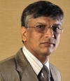
Welcome to the HiTech ISU
I would like to extend a warm welcome to you on your advent into the HiTech ISU. We are excited about the potential of this ISU
Truly, the sky is the limit for us
I wish you all the best for your future, and hope it is a mutually rewarding experience
Welcome to the HiTech ISU!
Nagaraj Ijari
Vice President and Global Head, HiTech ISU
nagaraj.ijari@tcs.com
+91 80 6725 1111
+91 98452 88723

Slide 4
HiTech TEG : Vision, Mission and Aspiration
Vision
HiTech TEG vision is to position TCS as IT services leader in HiTech market
Mission
To Support HiTech ISU in becoming the Strategic Partner of Choice for its customers
Aspiration
Technology Thought Leader
Make a Difference
First Choice
Brand HiTech

Slide 5
HiTech Organization Structure
ISU Heads
Nagaraj Ijari
Computer Platform & Electronics
PWC
TEG & Innovation Management
Software & Professional Services
Semiconductors
NC Venkatesh
Sivaram Parthasarathy
Bala Peddigari
Arun Prabhakar
Ankur Mathur
Delivery Optimization
Bid Management
Operations & Process Excellence
Ged Roberts
Sumit Bharti
Ged Roberts
PMO Head
Finance
HR
Marketing
RMG Head
Naveen Bolaingappa
C Murthy
Roshan Abraham
Abha Bajaj
Charudutta Ukey

Slide 6
























TCS Definition of the HiTech ISU Segments
HiTech Sub Industry Segments
PC Manufacturers
Mainframes, Mid-range Manufacturers
Storage & Peripheral companies
Business Applications
Infrastructure & Information Management
Database Management
System and Network Management
EAI and Middleware
Fabless Manufacturing companies
Foundries
Integrated Device Manufacturers
Equipment Manufacturers
Consumer Electronics
Electronic Equipment & Instruments
Accountancy
Legal
Analyst & Advisory
HR & Employment
Management & Marketing Consumer
Computer Platform and Services
Software
Semiconductors
Electronics
Professional Services
Similarity of Business & Technology Process Creates Competency Critical Mass
Similarity of Business & Technology process creates Competency Critical Mass

Slide 7
TCS HiTech ISU Offering Prism
Legal Management
Supply Chain Management
Price Management
eLearning and Education Solutions
Service and Warranty Management
High Tech Sales Management
Business Process Outsourcing
Storage Infrastructure Services
Web Accessibility Compliance Testing
Localization Testing
Web2.0 Portal
Rich Internet Application Framework
Enterprise Content Management
Dynamic Workflow Integration
Application Development and Maintenance
Infrastructure Services
Offerings
Business
Technology
Innovation
Labs
HiTech CoE
Product Engineering
SWAT
Domain
University
Storage Product Engineering and Consultancy
DLNA and Home Networking
VLSI Design
Engineering & Industrial Services
Product Lifecycle Management (PLM)
Embedded Systems
Enablers
Enablers
Computer Platforms & Services, Semiconductors, Electronics, Software and Professional Services

Slide 8
HiTech TEG & Innovation Management Engagement Model
Build World-class Offerings and Solutions
Deepen Relationships with Strategic Partners
Track technology, architecture and industry trends
Conceptualize offerings in line with trends
Leverage partner products and TCS R&D assets
Collaborate with CTO, Corporate TEG and other ISUs
To ensure Customer Centric Sustained and Managed Innovation, such that it becomes a channel for Ongoing Business and Customer Delight
Support Delivery Engagements
To build competency in key domains and ensure career development through a virtual learning environment

Slide 9
Technology Excellence Group & Innovation Management Org. Chart
Bala Peddigari
HiTech Technology Excellence Group & Innovation Management Head
Shobhna Bansal
ABIM CoE Lead
Ajay Parashar
Big Data CoE Lead
Kolluru Sudhakar
Cloud CoE Lead
Edwin Anand
Enterprise Architect & Innovation Management CoE Lead
Jitendra Maan
Java & OS CoE Lead
J Ramakrishna
MS & Assurance CoE Lead
Nishant Verma
Automation & Operational Engg.
Jabeen Begum
TEG SWAT Lead
Raj Vijay
BIPM CoE Lead
Venkata M
EAI Lead
Vidyasagar T
SharePoint CoE Lead
Ambily K K
MS .NET ,
Win 8 & TFS Lead
BalaKumar Ramanathan
MS BI Lead
Manishchandra K
Innovation Management Team Member
Maitreyi Gupta Innovation Management Team Member
Shalini Arora
Mobility CoE lead
Abhinav Jindal
Mobility CoE Team Member
Santosh Kumar
Mobility CoE Team Member
Venkat A
Assurance CoE Lead
Krishnachaitanya
Assurance CoE
Manish Rajput
Dynamic CRM CoE Lead
Gaurav Singh
BIPM CoE Team Member
Richa Agarwal
Innovation Management Team Member
Satyadev Madiraju
BIPM CoE Team Member
Mahesh Gubba
Innovation Management Team Member

Slide 10
HiTech TEG Focus – FY 2014-15
HIS
Solutions and Offering’s
Pre Sales /Bid Support
Branding & Thought Leadership
Delivery Support
Competency Development
Innovative Solutions
PoCs
Workshops with customers
Proactive Proposals
Innovative solutions in Bids
Analyst Interactions
Participate/Present in Industry Events
Publish offerings/ brochure on TCS.com
White Papers
Patents
Trends
Consulting Engagements
Project technical reviews
New Project kick-offs
Best Practice sharing
Focused Competency Program
Support L&D in competency development

Slide 11
HiTech TEG : Technical Focus Areas : 2014-15
JOSE: Java and Open Source
JOSE: Social and ECommerce
Microsoft
Assurance
ABIM and Big Data
Cloud and Emerging Tech
Enterprise Architecture
MS - BI /SQL Server 2012
Office 365 & Online
JBOSS
MuleESB
Pentaho
JasperSoft
eCommerce
Connecting Marketing Solutions
Cloud Testing
Product Testing
Information management
Data Virtualization
HP Converged Systems
Internet of Things
Domain Architectures
EA Frameworks
New Focus
Sharepoint 2010 & 2013
HTML 5
Windows 8
Open Source RIA
Liferay
MySQL
Social Analytics
Social Collaboration
Yammer
Globaliz’tion
Non-Functional Testing
Big Data
HPC
Cloud EAI
Visual Analytics
Open Stack
Redshift
EA Tools
Reference architectures
Strengthen
NET, Visual Studio 2012, TFS
PDW
Windows 7
Web 2.0
Portal Solutions
Java EE & OpenSource Tools
Jive
NewsGator
SFDC Chatter
Functional Testing
Automation Testing
BIPM
Analytics
ECM
WCM
Amazon Web Services
Windows Azure
Architecture development methods
Focus

Slide 12

Technology Excellence Group (TEG) - Engagement Model
Technology Drives at Accounts/Relationships
Innovation programs, TCM initiatives, Solution Architecture Groups, CoEs
Service Requests
Technical Solution & Estimation
Architecture Consulting
Competency Building
Critical project reviews
Corp TEG
Unit TEG
Offerings
Technical Capability
Consulting Assignments
Competency Framework
Innovative ideas and value creation
Delivery
Delivery
Pre-sales
Pre-sales
Architecture
Architecture
[OU] TEG Lead
Collaboration
Consulting Best Practices &Case studies
Industry trends, reference frameworks, Technical Papers,
Domain Capability
Delivery kits, Tools, KSS & Training
GCP
Delivery Acceleration
Team
CTO Innovation Labs
COE Lead 01 Lead
Presale/
Solution Team
HOUs
COE Lead 02 Lead
Asset Utilization Lead
Op Units
COE Lead N Lead
Notes:
This slide illustrates the engagement model of TEG with UTEG and Project teams. Projects teams by virtue of their being closed to the customers, give the service requests on technical solution, architecture consulting , project reviews, competency needs to TEG. These are then evaluated and converted to Technical capability (offerings and other assets), competency framework (Infrastructure and plans) , innovative solutions by CTEG / UTEG. TEG also collaborates with other units like GCP for Best Practices /case studies on Consulting assignments , CTO on technology trends and Innovative solutions (for NTDG particularly), HOUs for expertise in their realm (like Ent Sol and BPO in particular) and operating Units for Deployment .
It also shows broadly the way OU TEG is organized with a Delivery , Presales and Asset Utilization SPOCs . Then there are various technology COEs based on the business environment of the OU

Slide 13
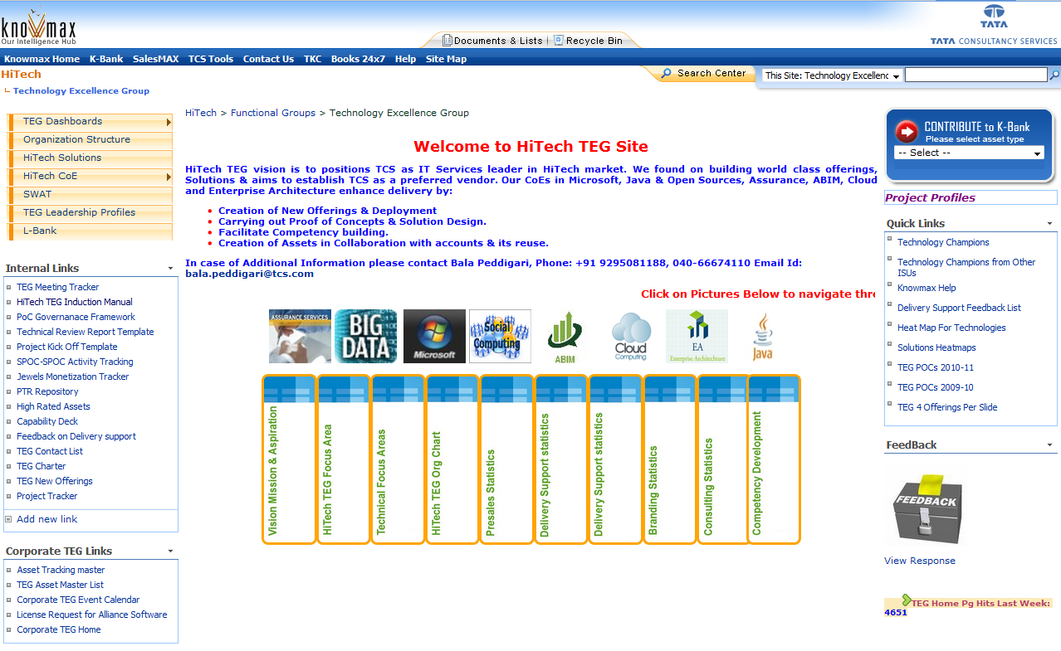
HiTech Technology Excellence Group Page
https://knowmax.ultimatix.net/sites/hitech-isu/fg/teg/default.aspx

Slide 14
Process Templates
S. No. | Process Area | Documentation
1 | Offering Creation Process
2 | Project Kick-off
3 | Technical Review
4 | Enterprise Architect – Competency Building Process
5 | TEG Activity List

Slide 15
TEG Trackers
Activity Tracker
https://knowmax.ultimatix.net/sites/hitech-isu/fg/teg/mscoe/activity_tracker.aspx
Project Tracker
https://knowmax.ultimatix.net/sites/hitech-isu/fg/teg/ProjectTracker/ProjectProfiles.html
Meeting Bridge Tracker
https://knowmax.ultimatix.net/sites/hitech-isu/fg/teg/Lists/Meeting%20Tracker/calendar.aspx
PTR Report – Action Item Tracker
https://knowmax.ultimatix.net/sites/hitech-isu/fg/teg/Lists/PTR%20report%20Action%20Item%20Tracker/Active%20Items.aspx

Slide 16
TEG Trackers
E2 – E3 Competency Tracking Site
https://knowmax.ultimatix.net/sites/hitech-isu/fg/teg/E2-E3Tracking/default.aspx
HiTech Technology Heat Map
https://knowmax.ultimatix.net/sites/hitech-isu/fg/HiTech%20Solution%20Central/his/Lists/Solutions%20Heat%20Map/AllItems.aspx
PTR Repository
https://knowmax.ultimatix.net/sites/hitech-isu/fg/teg/HiTech%20TEG/Forms/AllItems.aspx?RootFolder=%2fsites%2fhitech-isu%2ffg%2fteg%2fHiTech%20TEG%2fProject%20Technical%20Review%20Reports&FolderCTID=&View=%7b52100C99-70FD-437E-A5AB-90B9E3BEFEA0%7d
HiTech TEG - Offerings
https://knowmax.ultimatix.net/sites/hitech-isu/fg/teg/Documents/IOU%20Offering.xlsx
Proposal Tracker
https://knowmax.ultimatix.net/sites/hitech-isu/l-bank/HiTech%20ISU%20%20HTTD/HiTech%20TEG%20-%20Proposals%20Repository/

Slide 17
Other Links
TEG repository in KnowMax (place your important documents)
https://knowmax.ultimatix.net/sites/hitech-isu/fg/teg/mscoe/default.aspx
Champions link
https://knowmax.ultimatix.net/sites/hitech-isu/fg/teg/Lists/Technology%20Champions/Main%20View.aspx?SortField=Modified&SortDir=Desc&View=%7b6DF4D043%2d5856%2d4C65%2dADD0%2dAAFEB04E6A01%7d
Jewels link
https://knowmax.ultimatix.net/sites/teg-oi/Asset%20Tracker/Lists/Jewel%20Funnel%20Plan%20FY%201314/AllItems.aspx
Offerings
https://knowmax.ultimatix.net/sites/hitech-isu/fg/HiTech%20Solution%20Central/offerings/default.aspx

Slide 18
Technology Focus Areas
Learn technology which you like the most
Explore the breadth and depth of the technology and master it
Share the knowledge you have competency sessions
Inspire and motivate technology champions
Inculcate the technology zeal and passion across communities
Cultivate collaboration atmosphere and leverage the same to build assets
Participate in Technology Contests, events
Tweet and Blog
Create WIN-WIN Situation
Increase Brand Value of yourself
Utilize Community Channels to Scale-up
Mantra for success is Visibility
Broadcast your achievements and earn Recognition
Growth is the key for individual, TEG and Organization
Alignment of Self and Organization Goals are needed

Slide 19
References
HiTech ISU Main Page : https://knowmax.ultimatix.net/sites/hitech-isu/default.aspx
TEG Page: https://knowmax.ultimatix.net/sites/hitech-isu/fg/teg/default.aspx
Key TEG Contacts :https://knowmax.ultimatix.net/sites/hitech-isu/fg/HiTech%20Solution%20Central/his/Lists/Key%20HIS%20Contacts/AllItems.aspx

Slide 20
We are excited about the Future
Welcome to this New and Growing ISU

